Slide 1

2024 Spring SOCI2010 (Education and Society) Tutorial 7
Wanying LING
Department of Sociology
The University of Hong Kong
lingwany@connect.hku.hk
March 27, 2024

Slide 2
Updated Tutorial Schedule
Dates | Tutorial
T1 (Jan 31) | • Form groups. • Kick off the group project. • Select an article and start reviewing.
T2 (Feb 7) | • Summarise the article. • Sharing topics of interest。
T3 (Feb 21) | • Discuss the RQ/hypotheses. • Discuss data collection/analysis methods.
T4 (Feb 28) | • Finalise the RQ/hypotheses. • Discuss data collection/analysis methods.
T5 (Mar 13) | • Discuss data collection/analysis methods. • Finalise data collection/analysis methods.
T6 (Mar 20) | • Sharing of experiences and issues in data collection/data cleansing
T7 (Mar 27) | • Analyse the data - Qualitative (interviews) and quantitative (Descriptive Statistics)
T8 (Apr 3) | • Analyse the data
T9 (Apr 10) | • Analyse the data
T10 (Apr 17) | • Discuss implications. • Prepare presentation slides.
T11 (Apr 24) | • Presentation.

Slide 3
Feedback
Can you recommend some analyze method and teach us how to do？
Can you teach us some ways to analyse the results? We are quite clueless about it

Slide 4
Interview Checklist - 16 tips
1. Schedule Interviews in Advance
Schedule interviews well ahead of time and confirm with the interviewee the day before. Limit interviews to a maximum of two hours and ensure punctuality.
2. Comfortable Location
Allow the interviewee to choose a comfortable and distraction-free location. Avoid restaurants for formal interviews.
3. Equipment Checks
Before starting, check your tape recorder, batteries, and sound levels.
4. Preparedness
Have a list of issues and an opening question ready, but allow the conversation to flow naturally. Take notes even if recording.

Slide 5
Interview Checklist - 16 tips
5. Start Informally
Begin with casual small talk and transition smoothly into the formal interview. Explain the study and how the information will be used and protected.
6. Use of Stimulants
Utilize photos or objects when necessary to stimulate conversation.
7. Focus on Specifics
Concentrate on events or experiences behind beliefs or opinions. Use examples or instances instead of pressing with "why" questions.
8. Active Listening
Listen attentively, avoid giving advice or arguing, and interrupt only for clarification. Be warm and encouraging without being overly formal.

Slide 6
Interview Checklist - 16 tips
9. Sensitive Topics
Avoid questions that could damage reputations. Do not push for information on sensitive topics if discomfort is shown.
10. Cross-Verification
Use interviews to verify information from others discreetly. Share what is known and ask for additional details or corrections.
11. Observational Notes
Take note of the interviewee's surroundings and responses to family members, religious practices, and symbols. Observe their demeanor during the interview.
12. Demographic Data
Record basic demographic information to ensure the interview sample represents the congregation adequately.

Slide 7
Interview Checklist - 16 tips
13. Question Testing
Test interview questions with a spouse, friend, or study members before conducting the interviews, refining them as needed.
14. Social Dynamics
Be aware of the interpersonal dynamics during the interview, as these may affect the responses given.
15. Interviewer Selection
Preferably, interviewers should not be senior leaders of the congregation to avoid bias. Interviewers should also avoid dominating the conversation.
16. Influence Restraint
Interviewers should control any tendency to dominate or influence the interview unduly.

Slide 8
When you can accomplish 16 points, you can definitely do good interviews!

Slide 9
Basic Concept
id | var1 | var3 | var3 | var4 | var5
1 | 7.4 | Male | 0.21 | Yes | High
2 | 5.28 | Female | 0.36 | No | Low
3 | 3.35 | Female | 0.5 | Yes | Low
4 | 6.08 | Male | 0.83 | Yes | High
5 | 8.89 | Female | 0.56 | No | High
6 | 8.05 | Female | 0.43 | Yes | Low
7 | 7.55 | Male | 0.82 | Yes | Low
For statistical analysis, we think of data as a collection of different pieces of information or facts.
These pieces of information are called variables.
These values can be numerical or categorical (text-based), and categorical values can often be converted into numerical values for analysis purposes.
Notes:
In the table below variables var1 thru var5 are a collection of seven values, ‘id’ is the identifier for each observation.
This dataset has information for seven cases (in this case people, but could also be states, countries, etc) grouped into five variables.

Slide 10
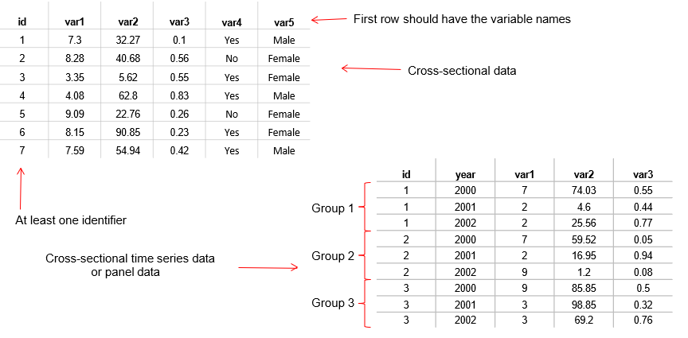
Data Structure
From Princeton DSS Libguides http://libguides.princeton.edu/dss
Notes:
For data analysis your data should have variables as columns and observations as rows.
The first row should have the column headings.
Make sure your dataset has at least one identifier (for example, individual id, family id, etc.)

Slide 11
Data Format
ASCII. The most universally accepted format. Practically any statistical software can open/read these type of files. Available formats:
Delimited. Data is separated by comma, tab or space. The most common extension is *.csv (comma-separated value). Another type of extensions are *.txt for tab-separated data and *.prn for space-separated data. Any statistical package can read these formats.
Record form (or fixed). Data is structured by fixed blocks (for example, var1 in columns 1 to 5, var2 in column 6 to 8, etc). You will need a codebook and to write a program (either in Stata, SPSS or SAS) to read the data. Extensions for the datasets could be *.dat, *.txt. For data in this format no column headings is available.
From Princeton DSS Libguides http://libguides.princeton.edu/dss

Slide 12
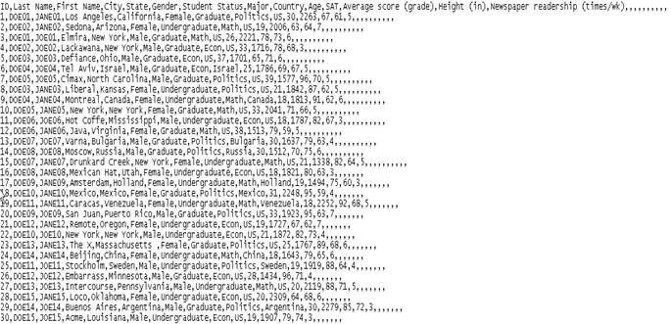
Data Format
Comma-separated value (*.csv)
From Princeton DSS Libguides http://libguides.princeton.edu/dss

Slide 13
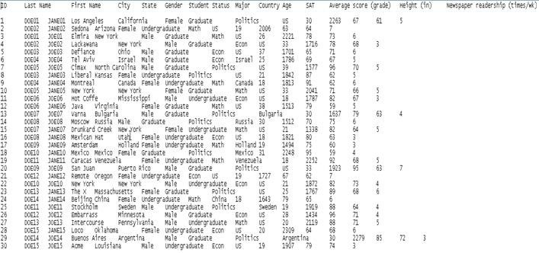
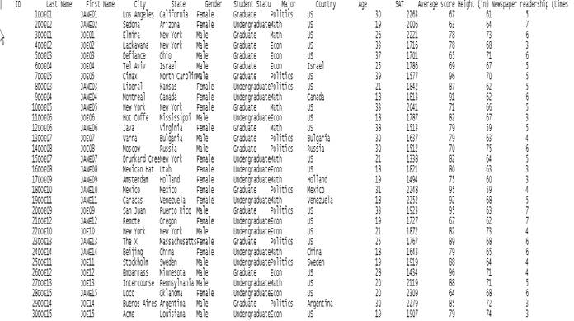
Data Format
Tab - separated value (*.txt)
Space - separated value (*.prn)

Slide 14
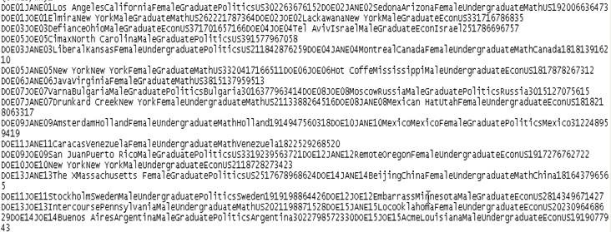
Data Format
Record form (fixed) ASCII (*.txt, *.dat). For this format you need a codebook to figure out the layout of the data (it indicates where a variable starts and where it ends). See next slide for an example. Notice that fixed datasets do not have column headings.

Slide 15
Other Formats
Features | Stata | SPSS | SAS | R
Data extensions | *.dta | *.sav, *.por (portable file) | *.sas7bcat, *.sas#bcat, *.xpt (xport files) | *.Rdata
User interface | Programming/point-and-click | Mostly point-and-click | Programming | Programming
Data manipulation | Very strong | Moderate | Very strong | Very strong
Data analysis | Powerful | Powerful | Powerful/versatile | Powerful/versatile
Graphics | Very good | Very good | Good | Good
Cost | Affordable (perpetual licenses, renew only when upgrade) | Expensive (but not need to renew until upgrade, long term licenses) | Expensive (yearly renewal) | Open source
Program extensions | *.do (do-files) | *.sps (syntax files) | *.sas | *.txt (log files)
Output extension | *.log (text file, any word processor can read it), *.smcl (formated log, only Stata can read it). | *.spo (only SPSS can read it) | (various formats) | *.txt (log files, any word processor can read)
From Princeton DSS Libguides http://libguides.princeton.edu/dss

Slide 16
Before you start
Once you have your data in the proper format, before you perform any analysis, you need to explore and prepare it first:
Make sure variables are in columns and observations are in rows.
Ensure you have all the variables you need for your analysis.
Verify that there is at least one unique identifier (ID) for each observation.
If working with time series data, confirm that you have all the years you want to include in your study.
Consistently represent missing data with either a blank space or a specific character, such as a dot ('.').
Create a backup copy of your original dataset to prevent accidental modifications.
Keep the codebook or data dictionary handy for reference.

Slide 17
Data Cleaning
If you are using datasets with categorical variables you need to clean them by getting rid of the non-response categories like ‘do not know’, ‘no answer’, ‘no applicable’, ‘not sure’, ‘refused’, etc.
Usually non-response categories have higher values like 99, 999, 9999, etc (or in some cases negative values). Leaving these will bias, for example, the mean age or your regression results as outliers.
88 | 2 | 0.15 | 96.58
90 | 3 | 0.22 | 96.80
92 | 4 | 0.29 | 97.09
93 | 1 | 0.07 | 97.16
95 | 1 | 0.07 | 97.23
999 | 38 | 2.77 | 100.00
Total | 1,373 | 100.00
This is a frequency of age, notice the 999 value for the no response.
From Princeton DSS Libguides http://libguides.princeton.edu/dss
Notes:
In the example below the non-response is coded as 999 and if we leave this the mean age would be 80 years,
removing the 999 and setting it to missing, the average age goes down to 54 years.

Slide 18
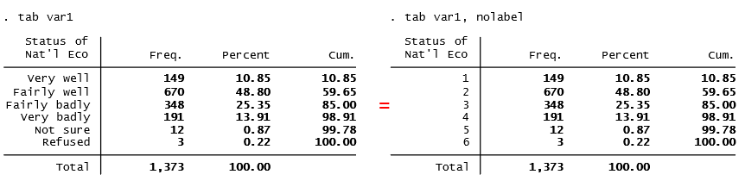
Data Cleaning
No response categories not only affect the statistics of the variable, it may also affect the interpretation and coefficients of the variable if we do not remove them.
From Princeton DSS Libguides http://libguides.princeton.edu/dss
Notes:
In the example below responses go from ‘very well’ to ‘refused’, with codes 1 to 6. Leaving the variable ‘as-is’ in a regression model will misinterpret the variable as going from quite positive to … refused? This does not make sense. You need to clean the variable by eliminating the no response so it goes from positive to negative. Even more, you may have to reverse the valence so the variable goes from negative to positive for a better/easier interpretation.

Slide 19
Descriptive statistics
Descriptive statistics are a collection of measurements of two things: location and variability.
Location tells you the central value of your variable (the mean is the most common measure).
Variability refers to the spread of the data from the center value (i.e. variance, standard deviation).
Statistics is basically the study of what causes variability in the data.
Location | Variability
Mean | Variance
Mode | Standard deviation
Median | Range

Slide 20
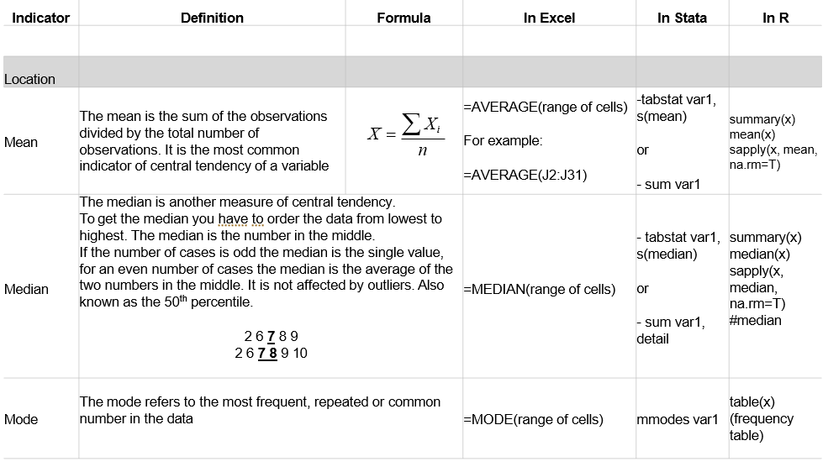
Descriptive statistics - location

Slide 21
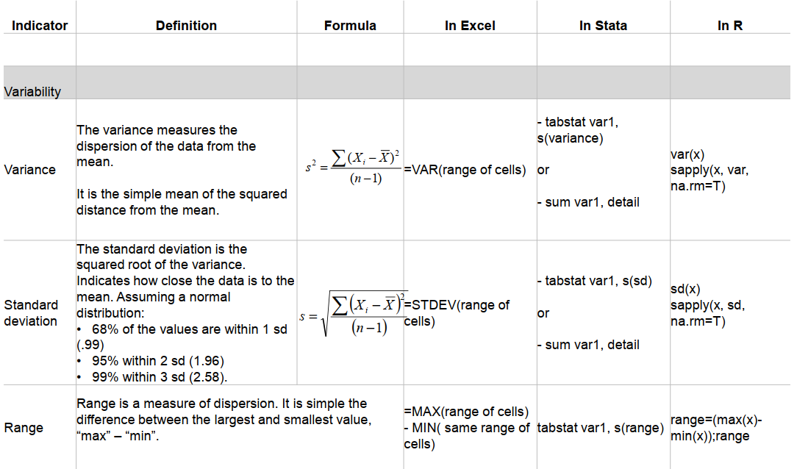
Descriptive statistics - variability

Slide 22
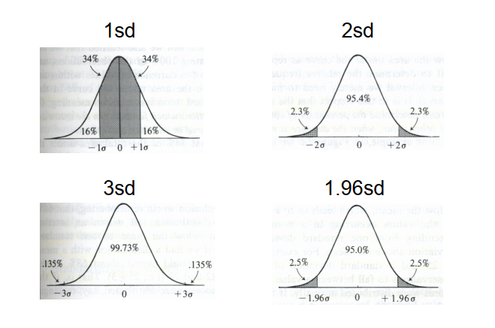
Descriptive statistics - standard deviation
Source: Kachigan, Sam K., Statistical Analysis. An Interdisciplinary Introduction to Univariate & Multivariate Methods, 1986, p.61

Slide 23
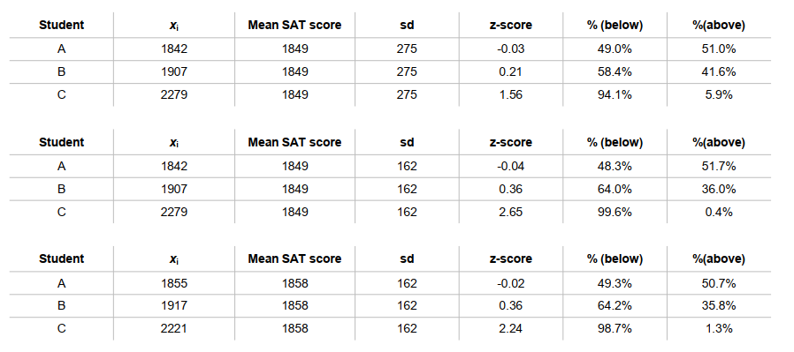
Descriptive statistics - z-scores
z-scores show how many standard deviations a single value is from the mean. Having the mean is not enough
NOTE: To get the %(below) you can use the tables at the end of any statistics book or in Excel use =normsdist(z-score). %(above) is just 1-%(below).

Slide 24
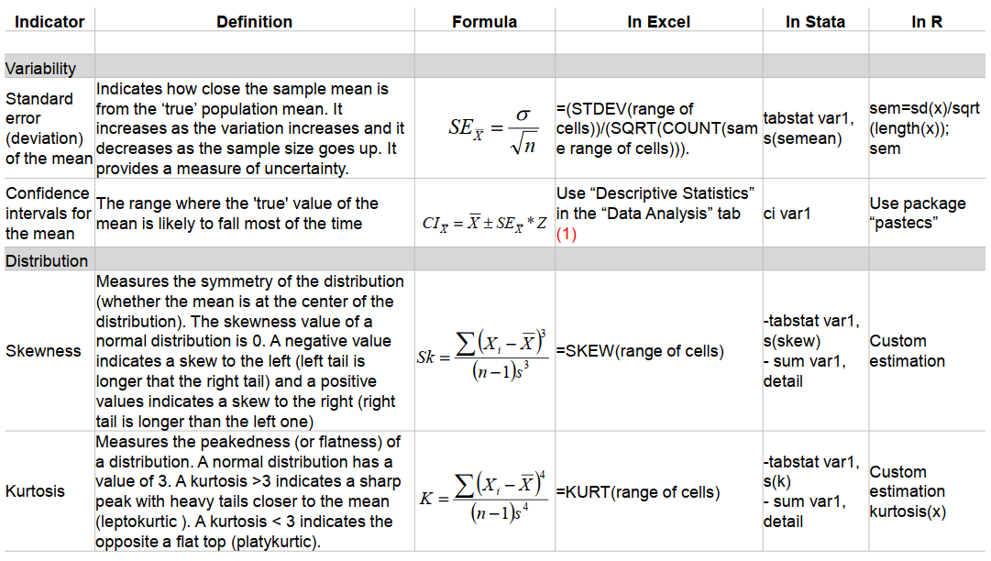
Descriptive statistics - distribution
Xi = individual value of X X(bar) = mean of X
n = sample size s2 = variance
s = standard deviation SE X(bar) = standard error of the mean
Z = critical value (Z=1.96 give a 95% certainty)
For more info check the module “Descriptive Statistics with Excel/Stata” in http://dss.princeton.edu/training/

Slide 25
Useful links
Guideline
UCLA Resources https://stats.oarc.ucla.edu/other/dae/
Princeton DSS Libguides http://libguides.princeton.edu/dss
W3school https://www.w3schools.com/EXCEL/index.php; https://www.w3schools.com/r/default.asp
Video tutorials
Excel Regression Analysis through the Toolpak https://www.youtube.com/watch?v=0lpfmFnlDHI
Stata short video tutorials https://www.stata.com/links/video-tutorials/
Step-by-Step SPSS https://study.sagepub.com/aldrich3e/student-resources/step-by-step-spss%C2%AE-tutorial-videos
Learn R in 39 minutes https://www.youtube.com/watch?v=yZ0bV2Afkjc

Slide 26
Hope these help!

Slide 27
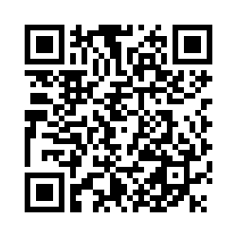
Tell me! (Please remember to select the corresponding date)
https://hku.au1.qualtrics.com/jfe/form/SV_0CAc6wAIyoTfH4W

Slide 28

Thank you!
Wanying Ling
lingwany@connect.hku.hk

